Slide 1
Beyond Buttons : Rethinking Control
Alex Wood
Experimental Interfaces for Novel Gameplay
An experience using custom made control systems designed for further immersion.

Slide 2

The Problem
This project aims to figure out how controllers and different input systems can impact immersion.
Reason for problem
Games Don’t Feel New
Influences
Experimental Games Production
What I aim to get out of it
New Skillset
Showpiece
Introduction
Research
Development
Outcome

Slide 3

The Solution
Iteration 1:
Building multiple controllers and comparing them using the same game and seeing how fun people find a game with the individual inputs being the independent variable.
Iteration 2:
Building a single controller, with lots of different input methods and measuring how much that is preferred over traditional inputs.
Introduction
Research
Development
Outcome

Slide 4

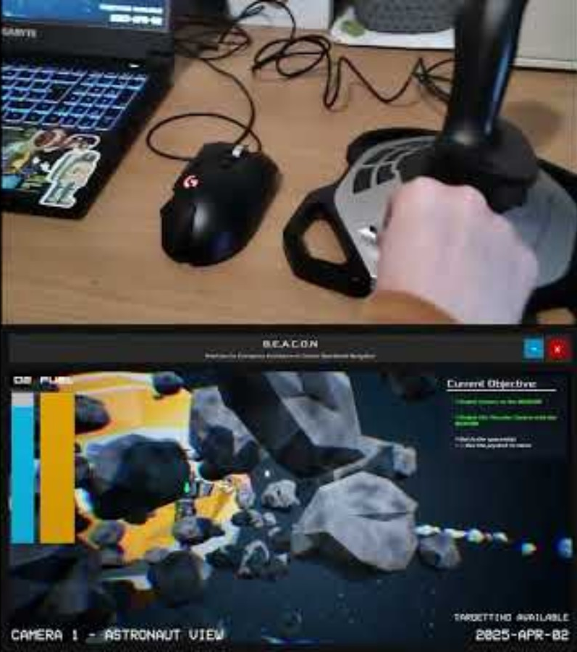
Demonstration
Demonstration video of Gameplay
Play in PowerPoint
Play in Browser
Introduction
Research
Development
Outcome

Slide 5

Feasibility of Project
Is this viable in industry?
Wii
Racing Rigs
Staffs Arcade Cabinet
Is there a gap in the market?
GradEX
Experimental Games Production
(Only Course In UK)
Not How Games Are Designed
Introduction
Research
Development
Outcome

Slide 6

Existing Systems
Special effect
Support for Disabilities
Therapy Routes
EGX Leftfield
Steel Battalion (~£300)
Museums
Introduction
Research
Development
Outcome

Slide 7

Circuitry
Circuit components
Development Boards
Input sensors
Ultrasonic Ranging
Dials & Switches
Output Systems
Printing
Screens
Vibration Motors
Relating to Immersion
Introduction
Research
Development
Outcome

Slide 8

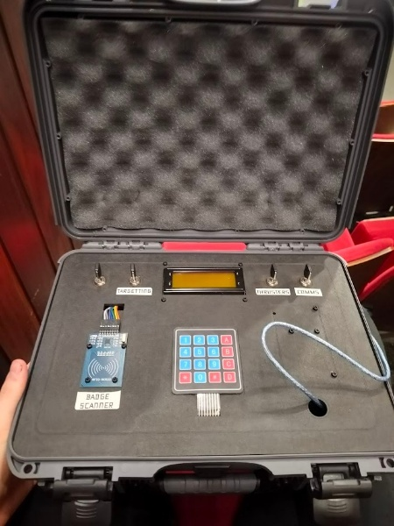
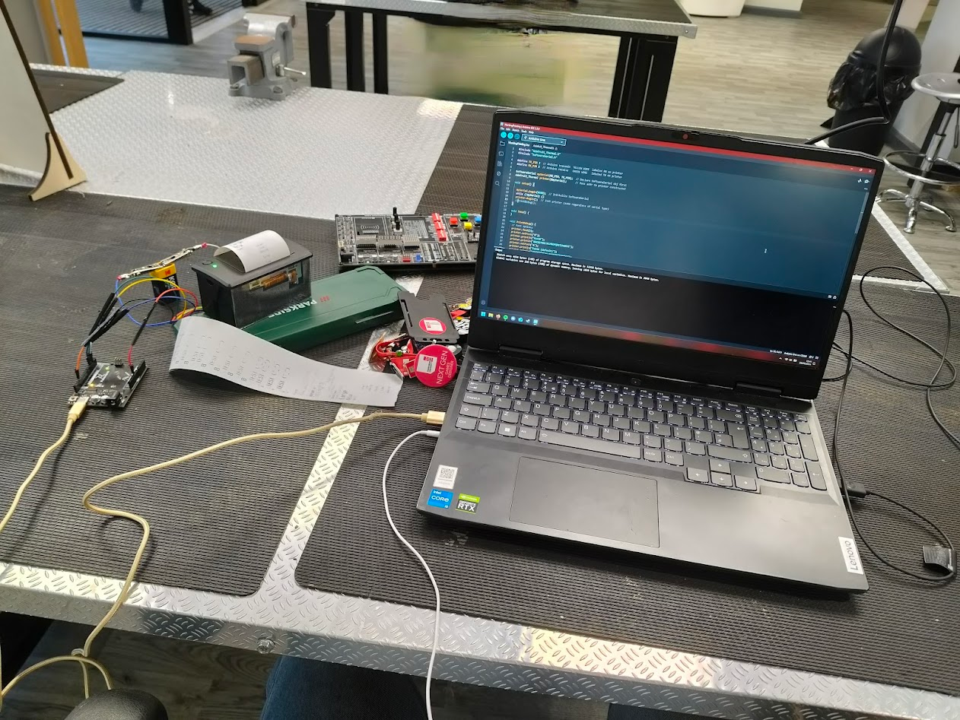
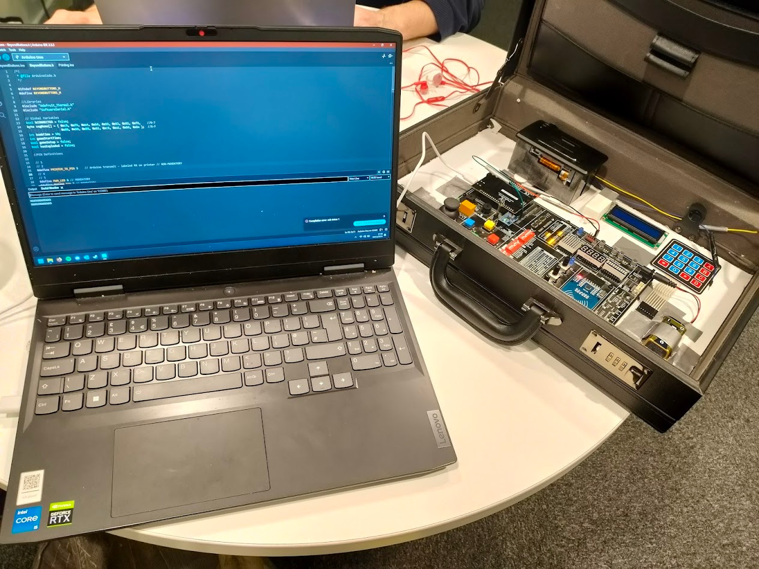
Controller
B.E.A.C.O.N
Components Included:
4x Key Switches
RFID Reader
4x4 Keypad
LCD Screen
Hot-Swappable Intergration
Introduction
Research
Development
Outcome

Slide 9

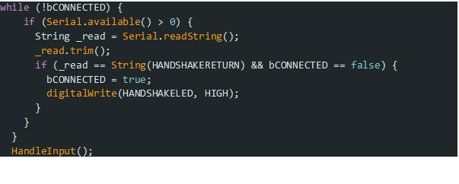
Arduino
Different Arduino systems
Handshake Protocol
Input Interpretation
Introduction
Research
Development
Outcome

Slide 10
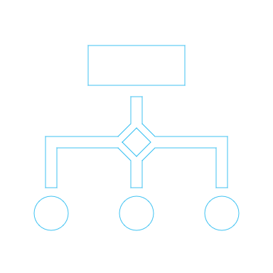
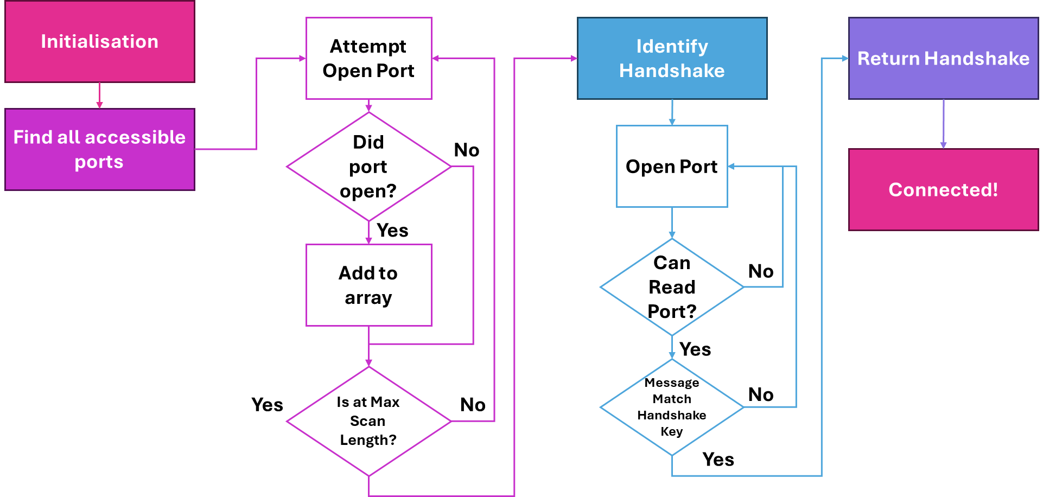
UE Interface
Introduction
Research
Development
Outcome

Slide 11

Game Elements
Level Design
Asteroids
Junk
Space Station
Tutorialisation
Objectives
Markers
Astronaut
Thrusters
Cameras
Introduction
Research
Development
Outcome

Slide 12

User Testing
Quantitative
Component Specific
Feasibility of Project
Immersion
Qualitative
Improvements to Game
Best Features
Bugs
Ethics
ID Cards
Introduction
Research
Development
Outcome

Slide 13

Feasibility in Industry
Financing
Rebuild Cost
Marketing sells itself
Large Scale Production vs One of a Kind Museum Pieces
Unique selling point
Handheld Controller using new input methods
Introduction
Research
Development
Outcome

Slide 14
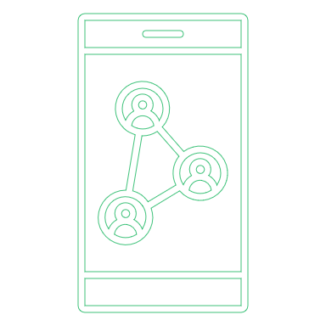
Marketing & Networking
Marketing & Showcasing, Events & Demonstrations
GradEX
LetsTalkGames @ Leamington Spa
LinkedIn
Communications with Companies
Special Effect
Ubisoft
Snappy Gurus
EGX Left-Field
Games Conventions
Introduction
Research
Development
Outcome

Slide 15

Future of the Project
Taking this project further
Key Switches
Full Incorporation Into Board
Sound
Lights
Taking these skills further
Masters Project
Arcade Cabinet
Freelance Projects
Introduction
Research
Development
Outcome

Slide 16

Outcome of Project
Outcome of project
What was produced?
Quality of work
Am I glad I did this project?
What did I learn?
Introduction
Research
Development
Outcome

Slide 17

The Answer
How do controllers and different input systems can impact immersion.
“Controllers and input systems can massively alter immersion by using tactility and realism. Using components relevant to the scenarios the game aims to imitate sells the feeling of immersion massively and can create new, novel experiences unique to a specific game.”
Introduction
Research
Development
Outcome

Slide 18




Questions?

